Slide 1
ASSIGNMENT 2
ANSWER KEY AND COMMON ERRORS

Slide 2
Question 1
Out of 14

Slide 3
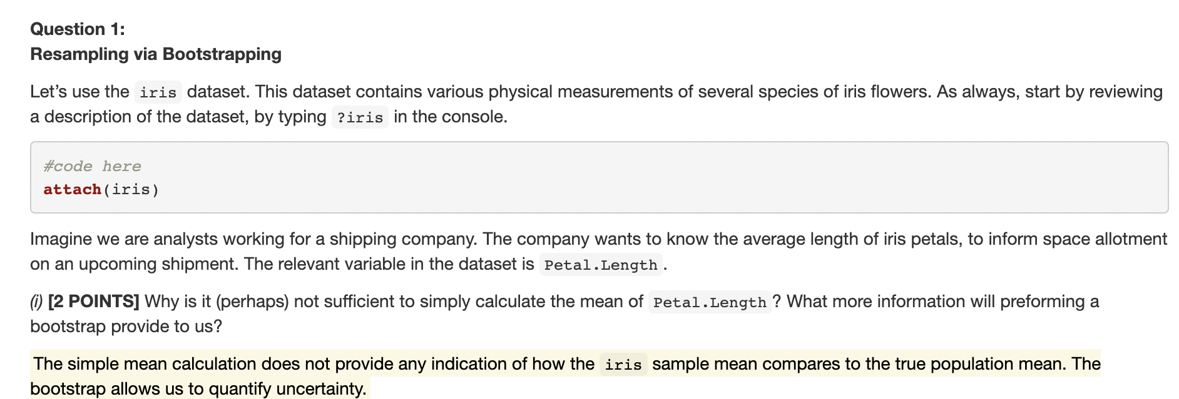
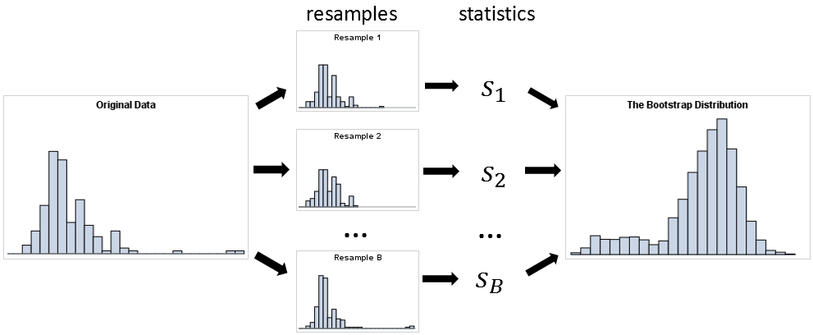
i.e., mean1
mean2
i.e., distribution of mean is closer to the true
population mean and doesn’t look like the
sample mean from the original data!
https://blogs.sas.com/content/iml/2018/12/12/essential-guide-bootstrapping-sas.html

Slide 4
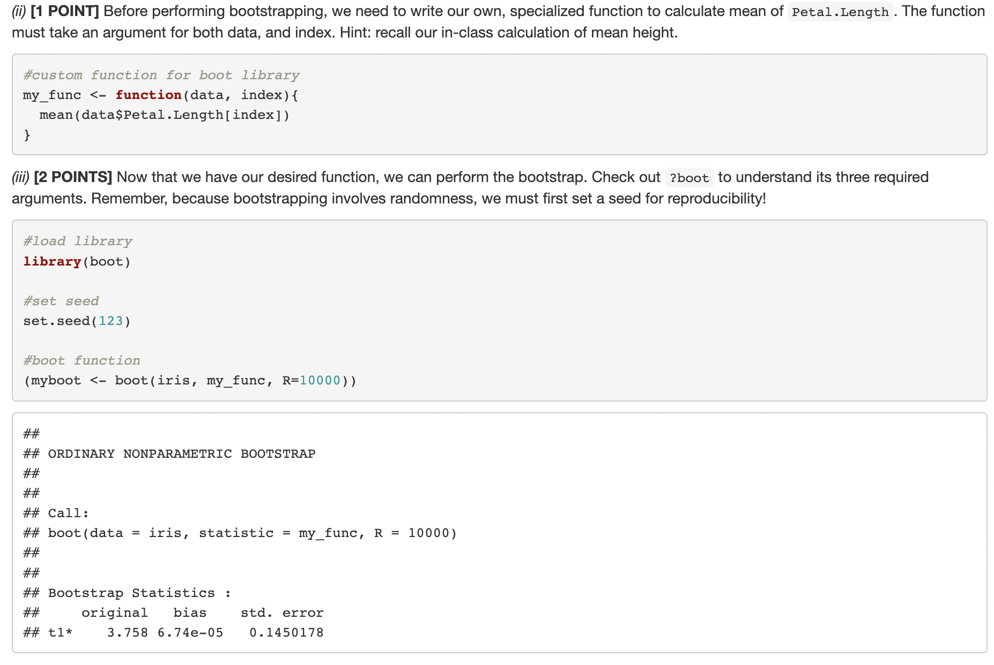
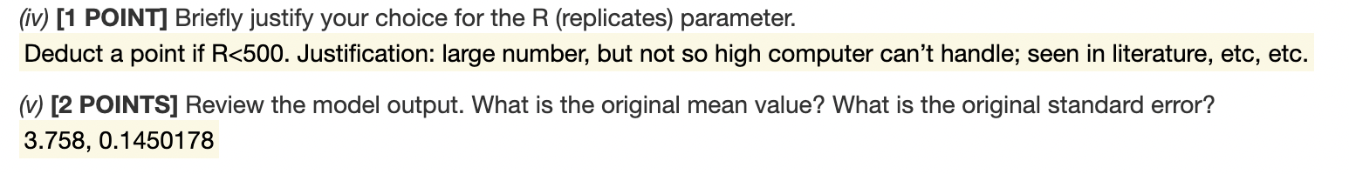

Slide 5
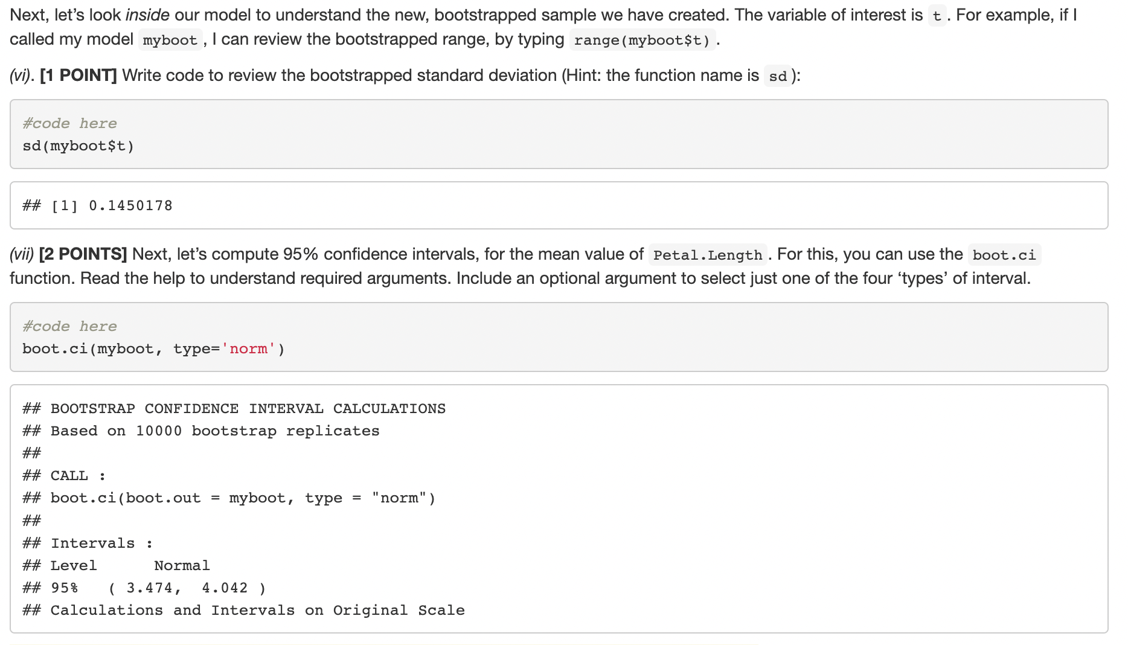

Slide 6
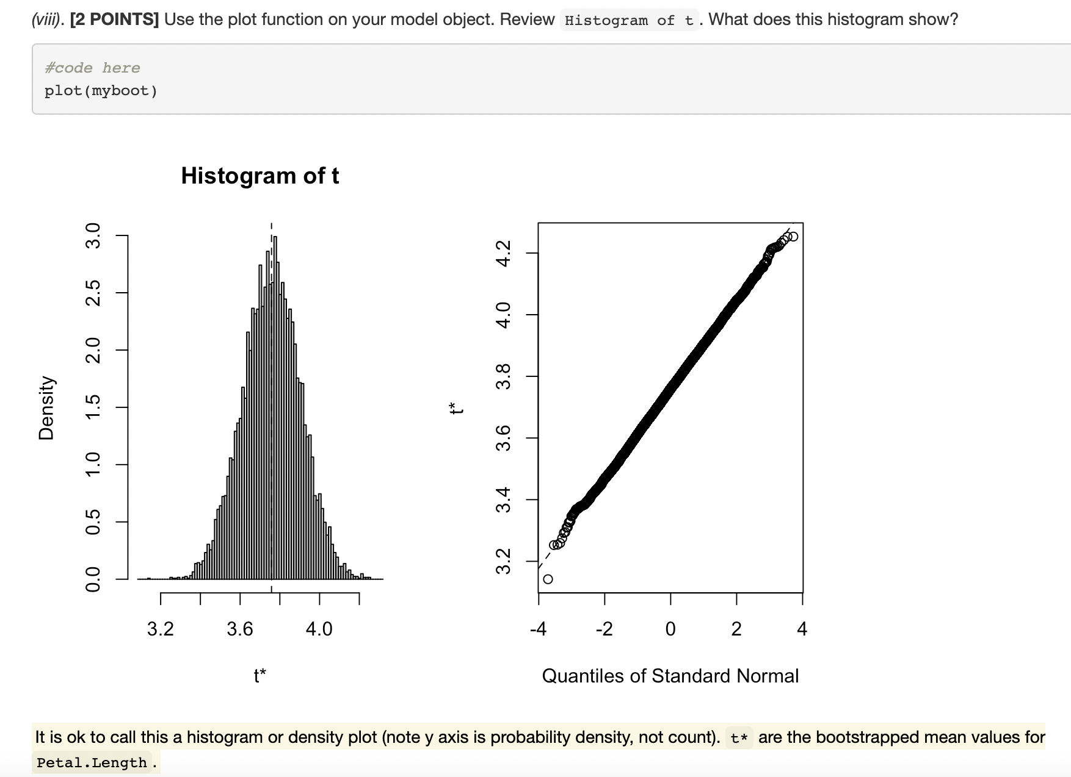
Common error
based on bootstrap mean and 95% CI

Slide 7
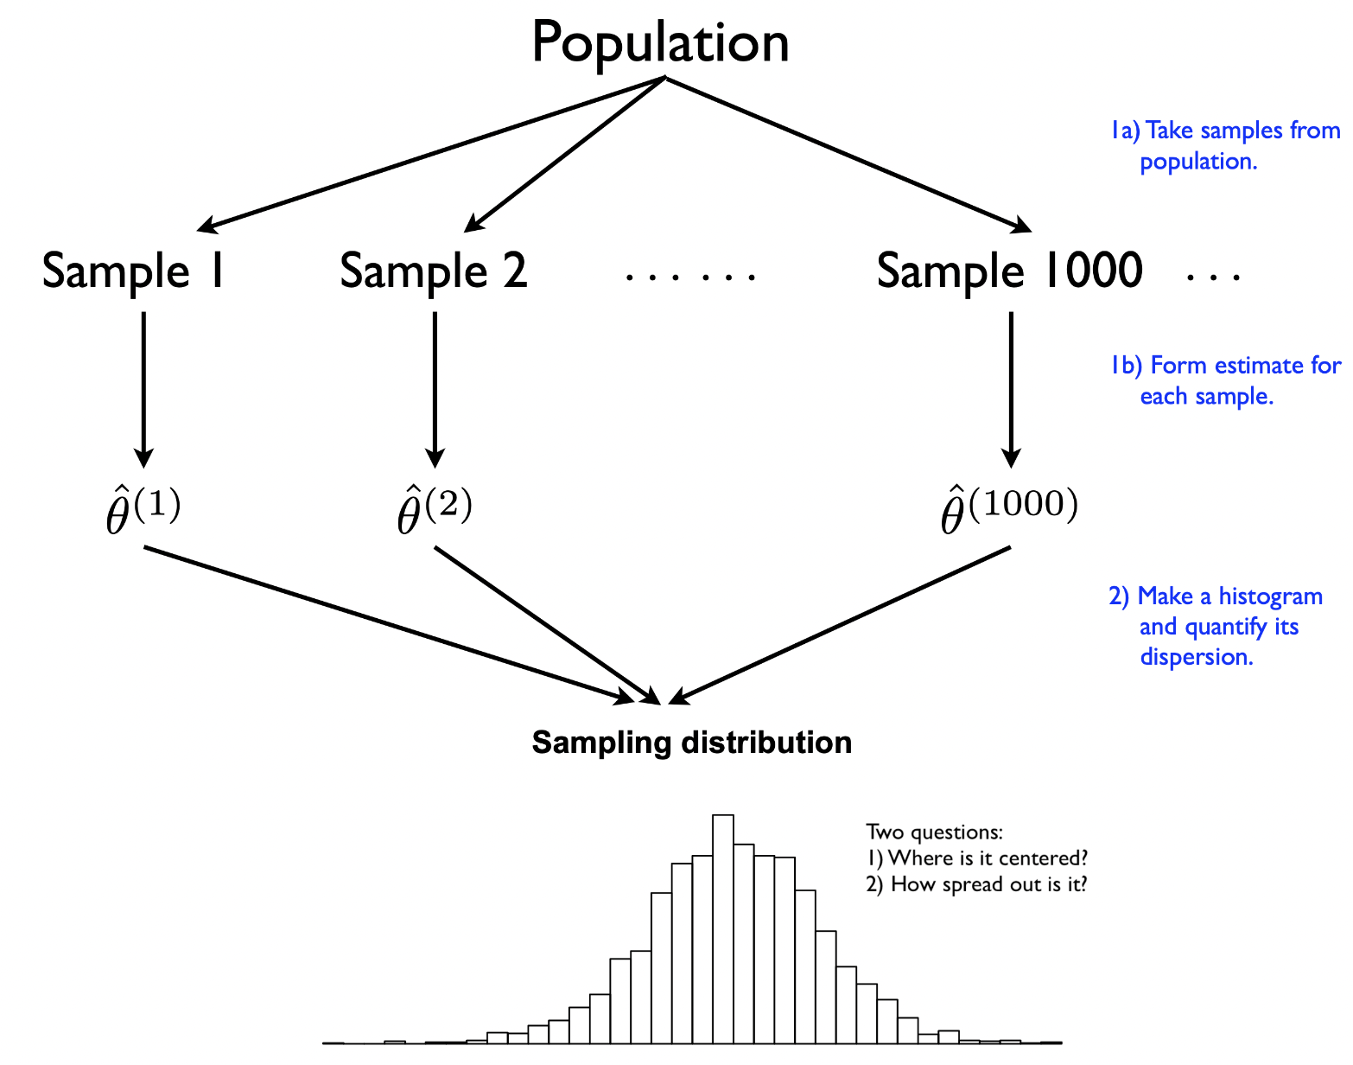
What the histogram represents!
Common error
sampling distribution of our test statistic!
Gives us information about the center as
well as the spread of the estimates
https://bookdown.org/jgscott/DSGI/the-bootstrap.html

Slide 8
Question 2
Out of 15

Slide 9
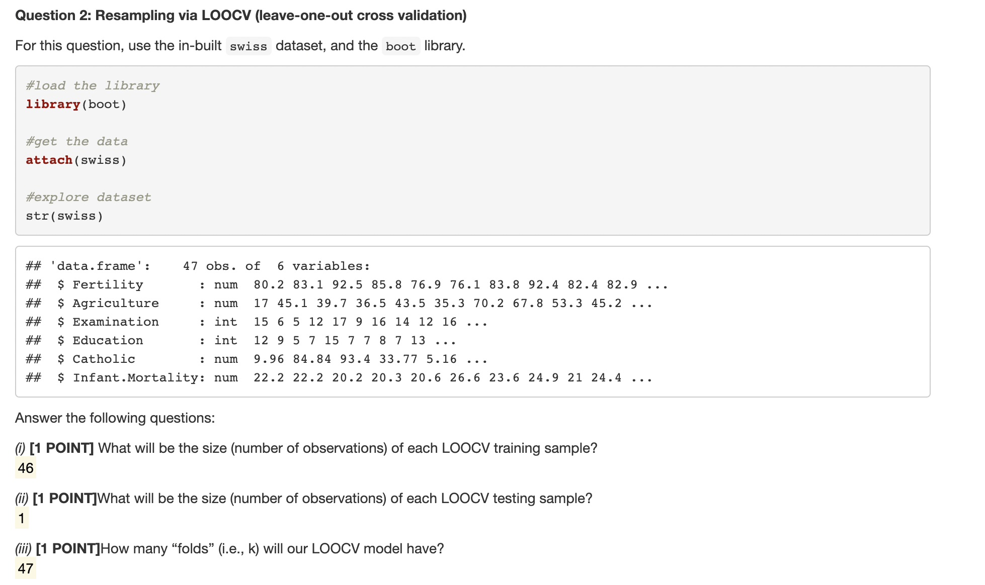
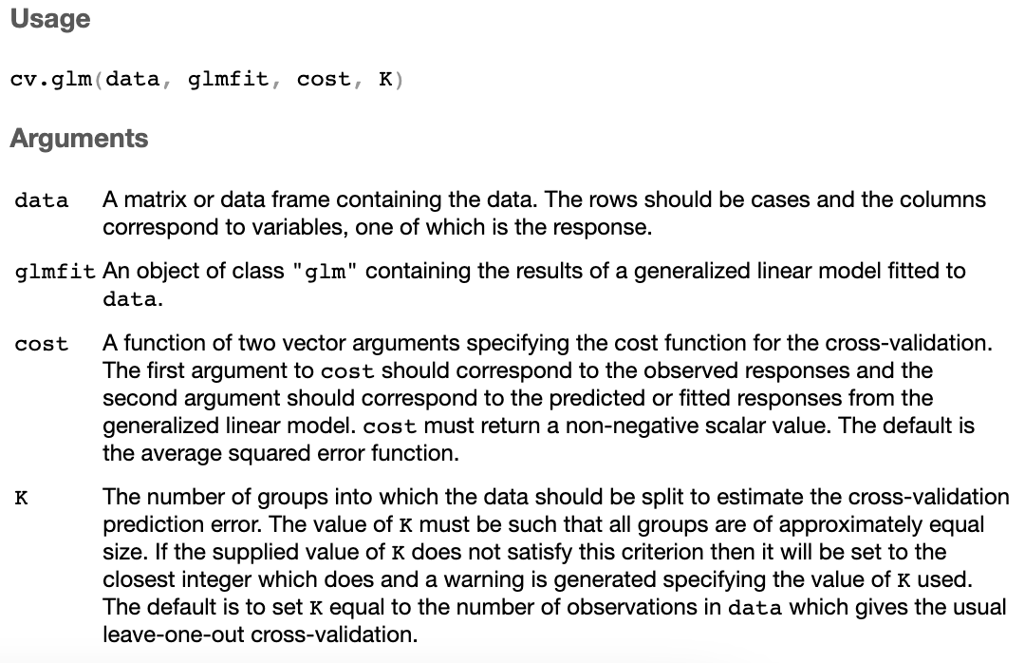
Note: ?cv.glm to find out info about arguments
47 observations, leave out 1 → 46!
Leave-1-out → 1!
Folds would be = the number of observations → 47!

Slide 10
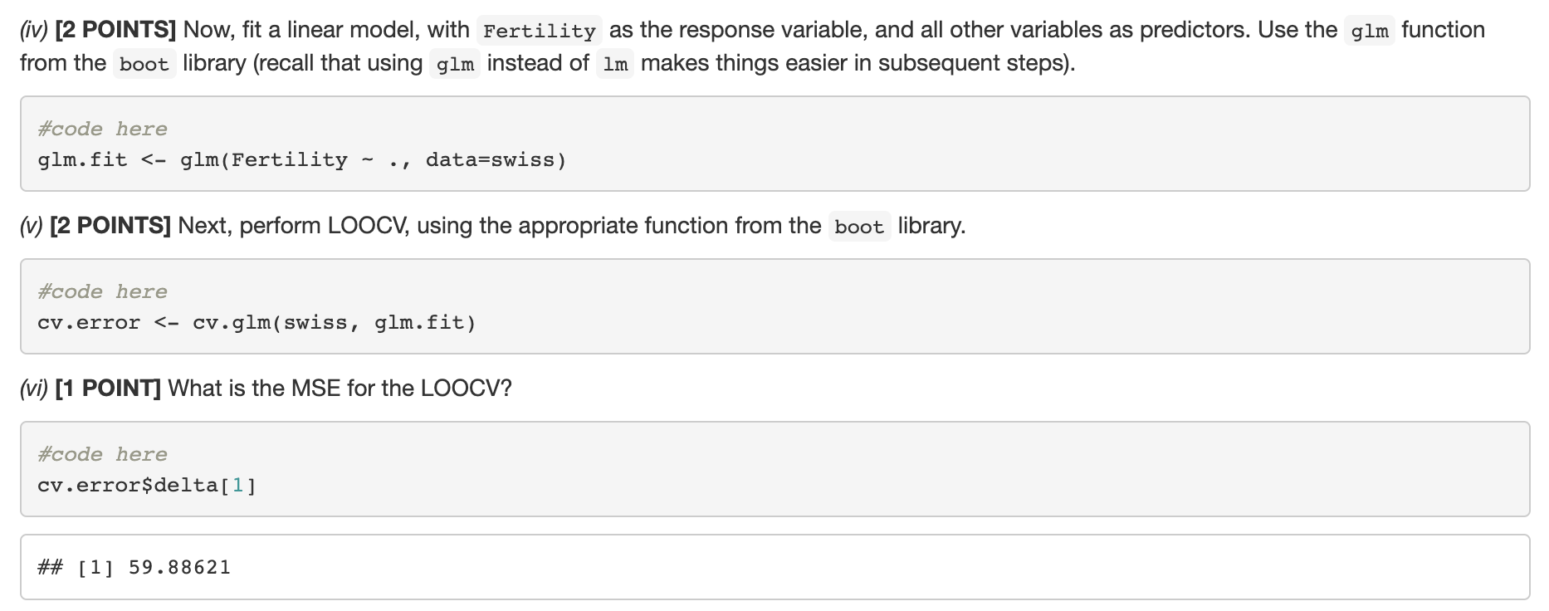
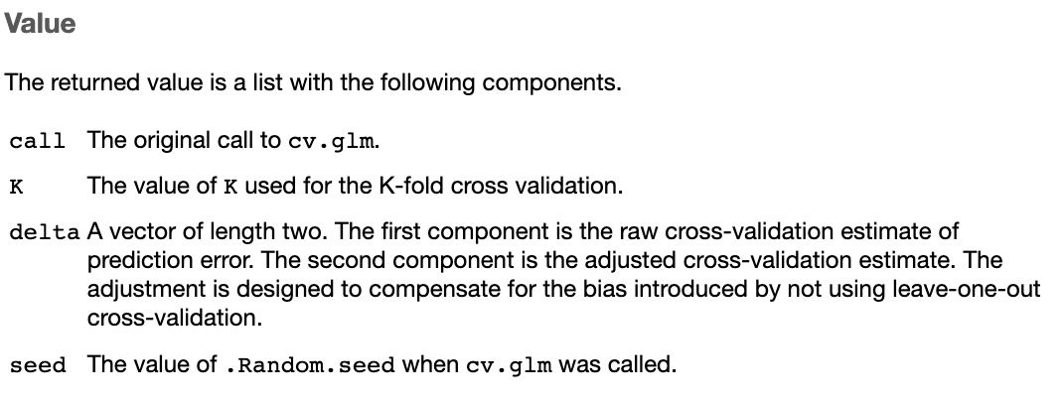
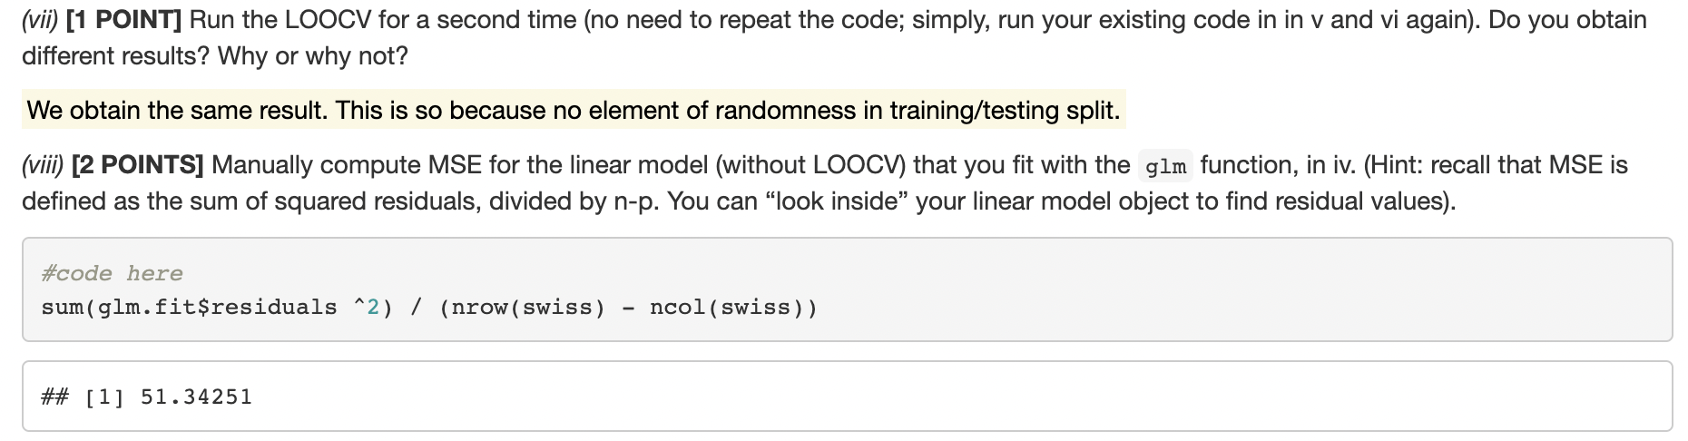
Note: ?cv.glm to find out info about returned values
sum(glm.fit$residual^2)/n OR mean((glm.fit$residuals)^2)
44.78815
44.

Slide 11
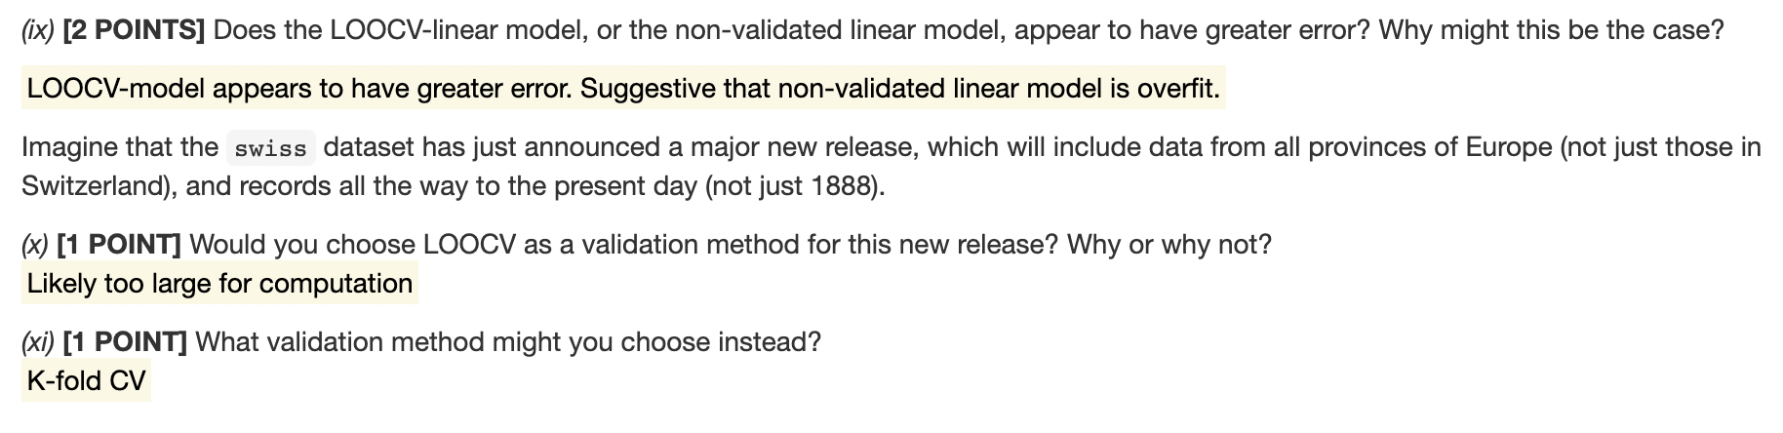
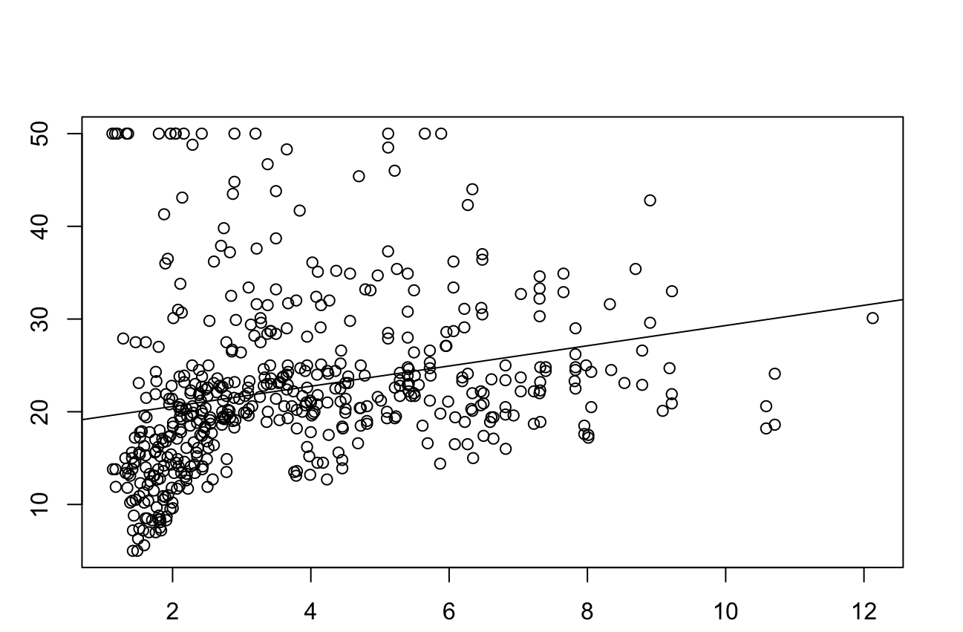
Example of residuals
Mean Squared Error measures how close a regression line is to a set of data points.
It is a risk function corresponding to the expected value of the squared error loss.

Slide 12
Question 3
Out of 23

Slide 13
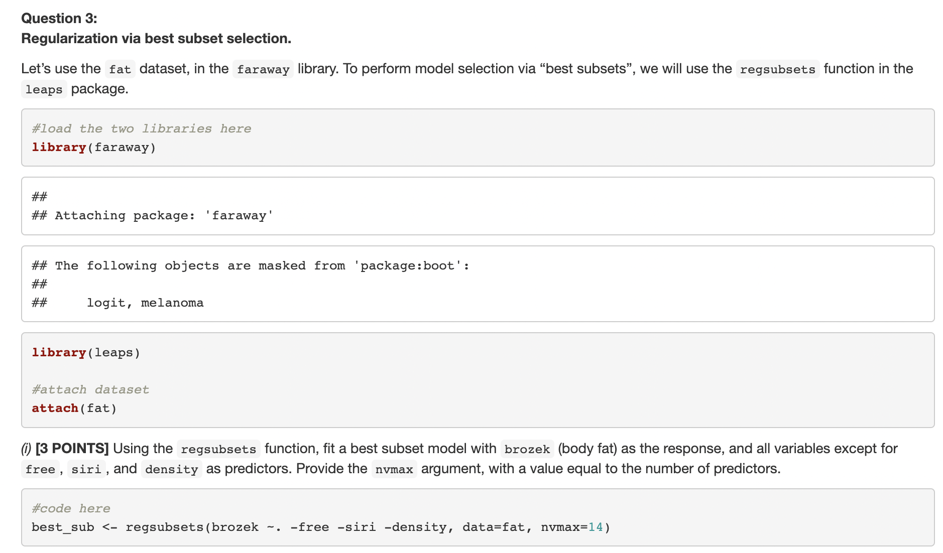
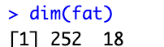
18 columns, remove 3 predictors and 1 response outcome = 14

Slide 14
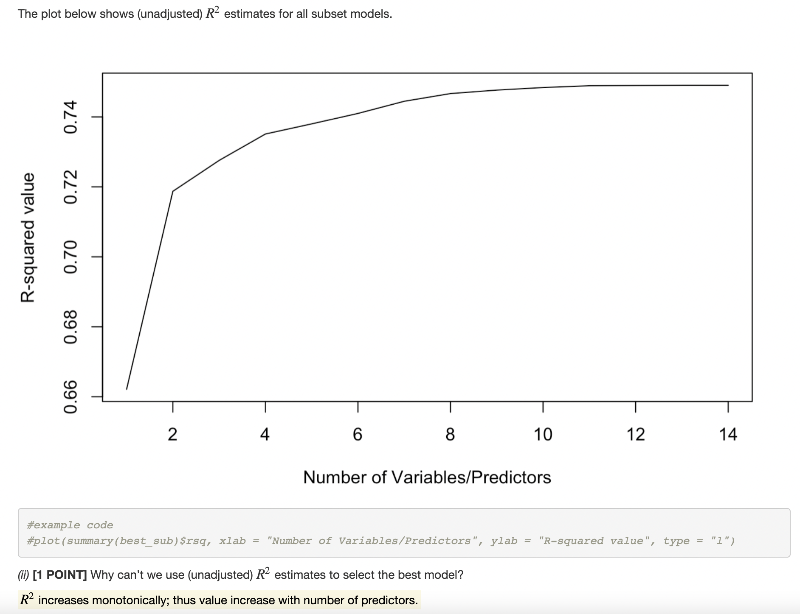

Slide 15
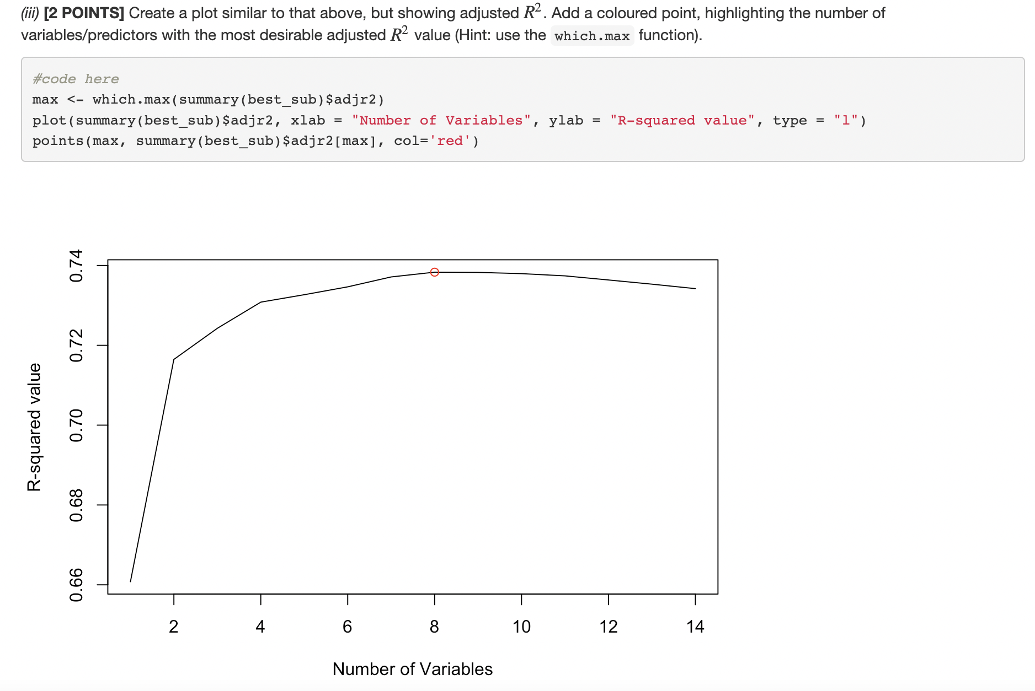

Slide 16
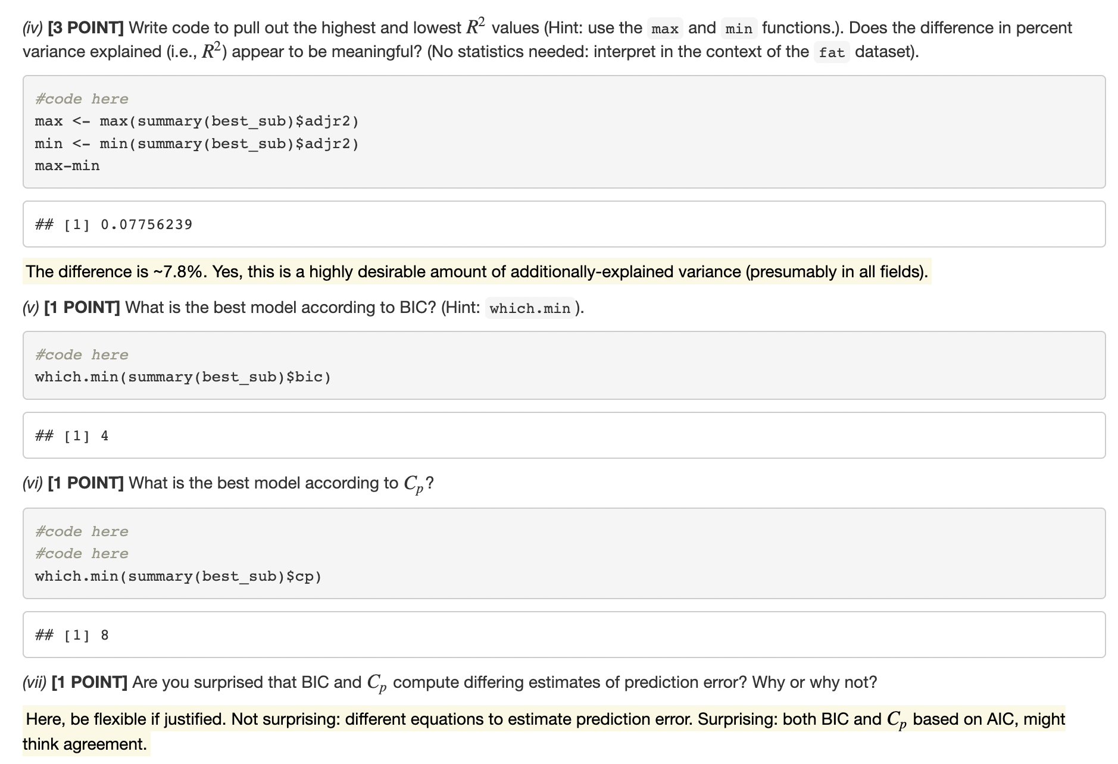
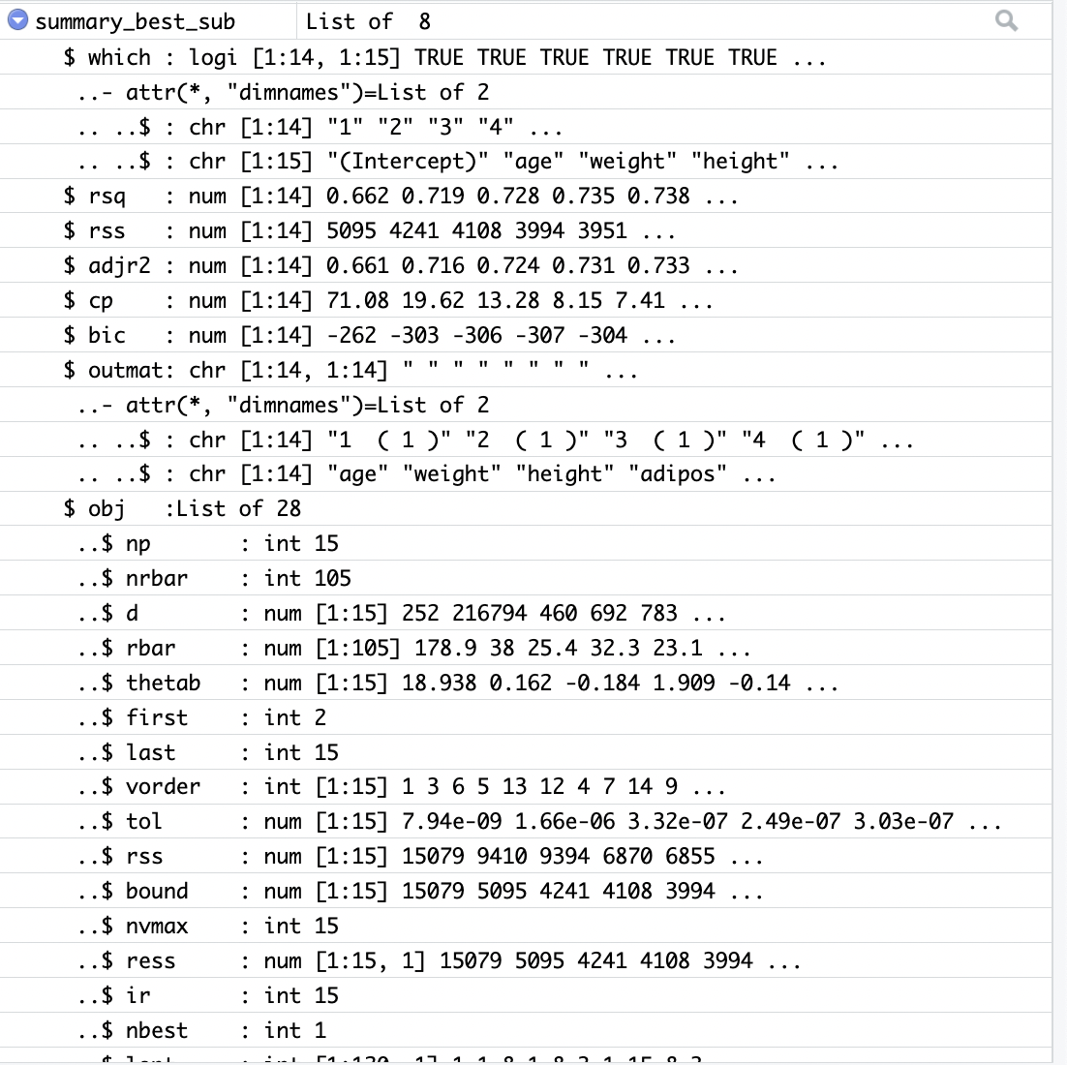
>summary_best_sub <- summary(best_sub)
GOAL: Minimize prediction error
Note, BIC statistic generally places a heavier penalty on models with many variables, and hence results in the selection of smaller models than Cp.

Slide 17
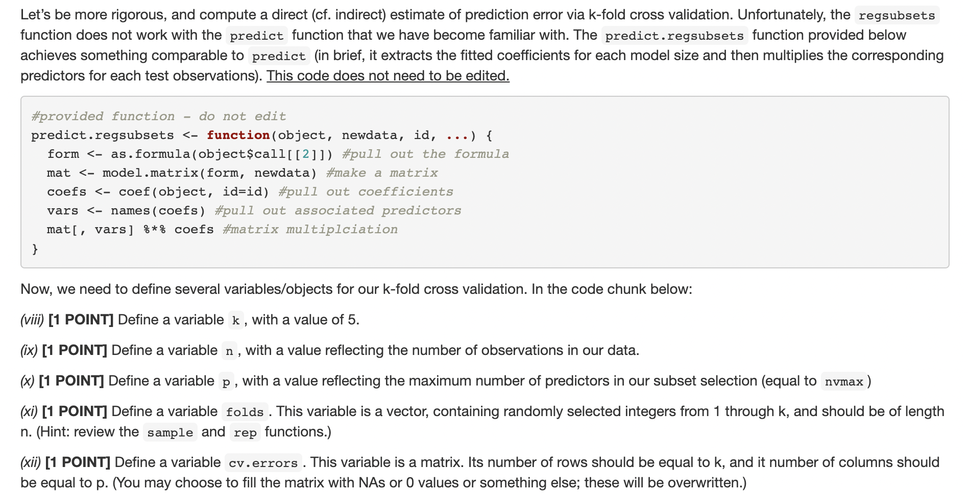
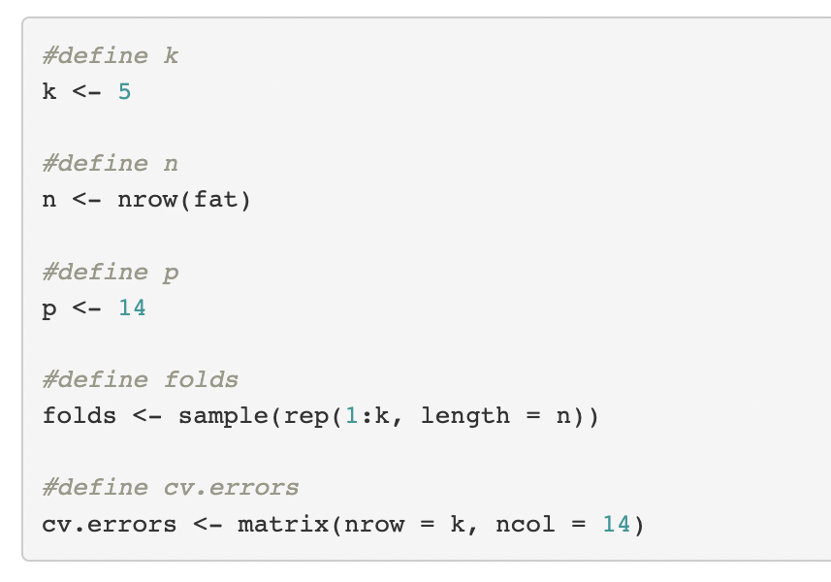

Slide 18
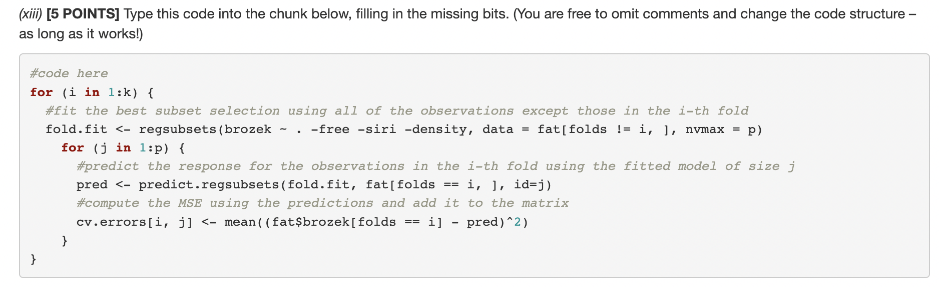
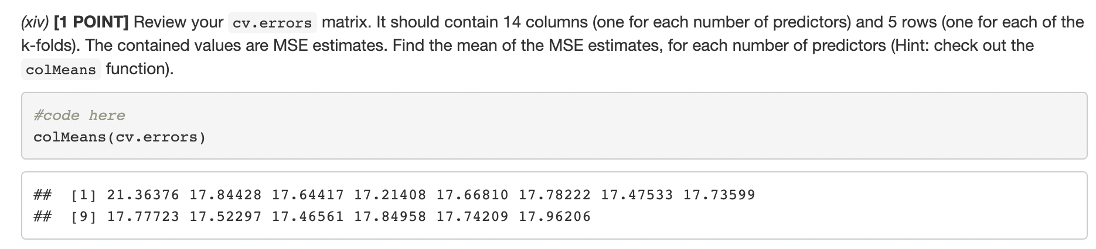

Slide 19
BONUS
Out of 5

Slide 20
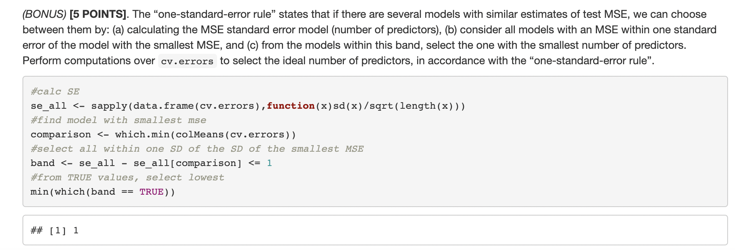
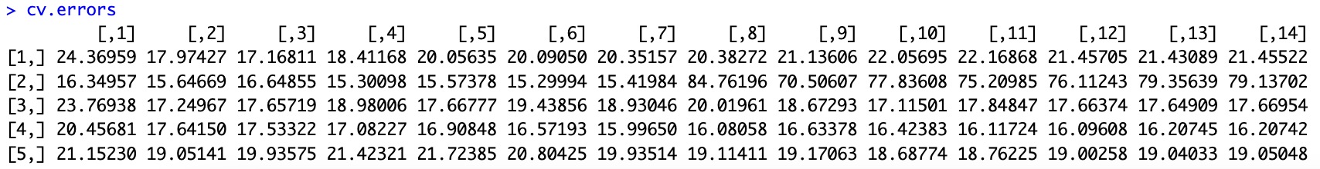
RECALL:

Slide 21
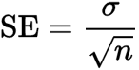
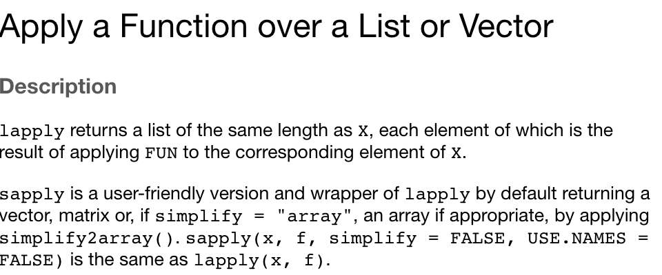
Step 1: calculate the standard error for each MSE in the cv.errors matrix
Common error
SE=standard error of the sample
sigma=sample standard deviation
n=number of samples

Slide 22
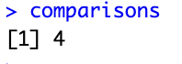
Step 2: Find the model with the smallest MSE, then take all models with MSE within one standard error of that model
RECALL:

Slide 23
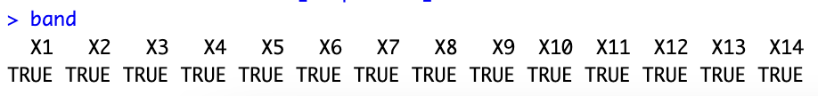
Step 2: Find the model with the smallest MSE, then take all models with MSE within one standard error of that model
Take only those in which se_all – se_all[4] is less or equal to 1
It seems they all are!

Slide 24
Step 3: from the models in this band, select the one with smallest predictors

